Slide 1

Stock Predictions
To Bull Or To Bear?

Slide 2

PROJECT TEAM
TEAM
Soo Bin Im
Meardreed Vilmeus
Max Young
Priya Jain
GitHub Repository
https://github.com/priyajainnyc/final-group-project-4-azure

Slide 3

PROJECT OVERVIEW
Stock Predictions
MACHINE LEARNING
Buy, Sell or Hold?
Using Yahoo! Finance API Published To Azure Web Service
SVR Algorithm
Accuracy Model
VISUALIZATIONS
SENTIMENT ANALYSIS
AI Stock Analysis Using Tableau
Percentage Trend Using NLTK News API Library

Slide 4
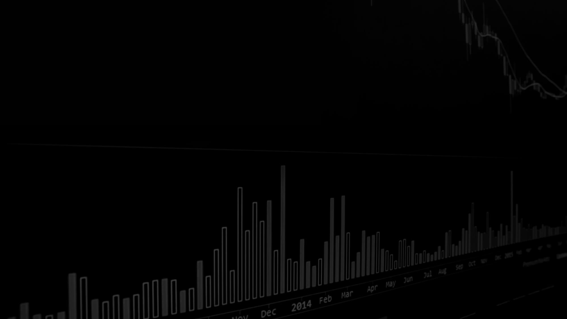
DEPENDENCIES
Pandas
Python
HTML
CSS
Numpy
Scikit-learn
Dash
Flask
NLTK Library
Yahoo! Finance API
Finviz Data
Tableau
Azure Web Services

Slide 5

PROJECT DESCRIPTION
Stock Prediction Web Application Using Dash and SVR Machine Learning
This project aims to provide a simple yet effective tool for stock market investors to visualize company stock data and make predictions based on machine learning models.
The web application is built using the dash framework, a python library for building web applications with interactive user interfaces.

Slide 6

AI STOCK PREDICTIONS
BUY
HOLD
SELL
25 Buy Recommendations with Total Market Cap of $14.56B
26 Hold Recommendations with Total Market Cap of $2.34B
21 Sell Recommendations with Total Market Cap of $580M

Slide 7

VISUALIZATIONS
VISUALIZATIONS
AI STOCK ANALYSIS
We've provided the below listed visualizations for AI specific stock data pulled from Finviz in a Tableau dashboard as well as a sentiment analysis from the nltk library data
Market Cap With Team Recommendation Category
Stock Current vs. Target Price
Number Of Employees By Sector
Sales & Profit Margin % With Team Recommendation Category
EPS Growth With Team Recommendation Category
Performance % Past Year With Team Recommendation Category
Target vs. Current Price With Team Recommendation Category
Stock Price 52 Week Hi, Lo, Current vs. Target Price
Sentiment Analysis

Slide 8

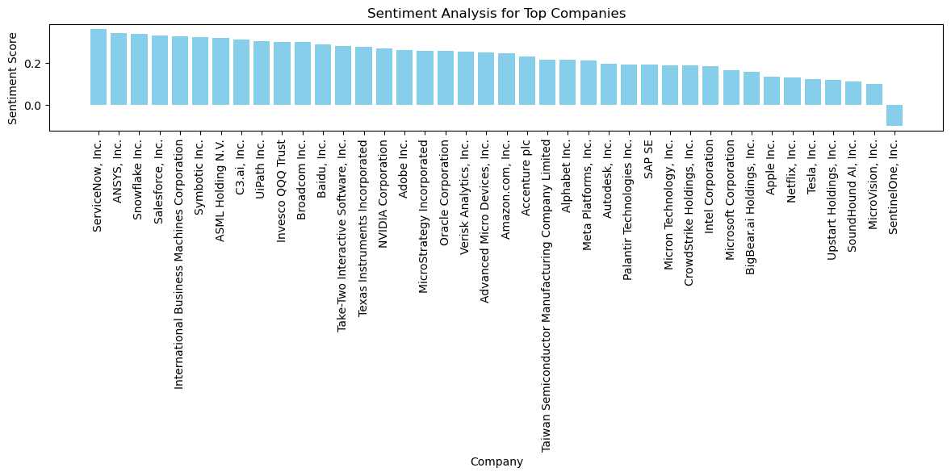
COMPANY OVERVIEW

Slide 9
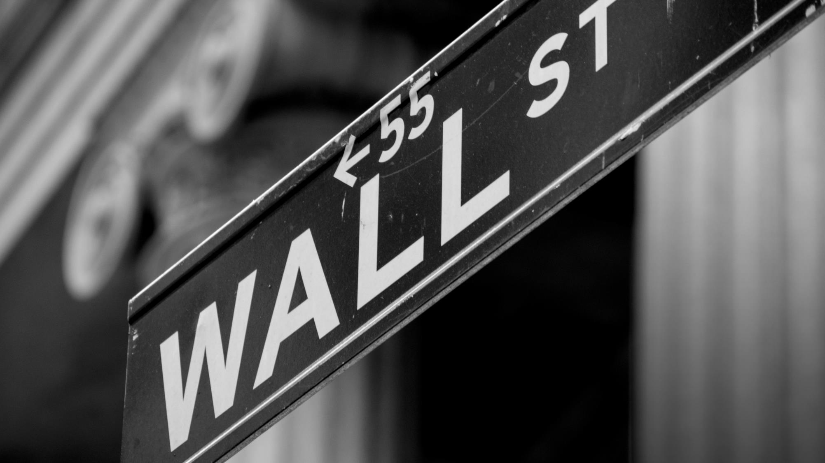
Thank You
Questions?

